Slide 1
DG Justice and Consumers
INDICATORS
Quantitative report on Outputs
By A4. Programme Management Unit
DG Justice

Slide 2
Application Form => FORECAST
Final Report => ACHIEVED RESULTS

Slide 3
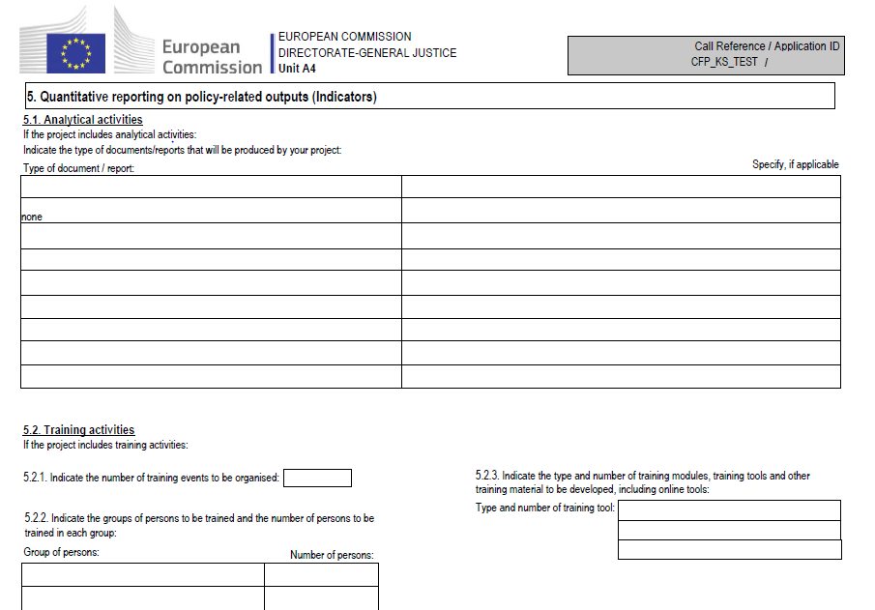
What are the indicators?
1) Analytical activities 2) Training activities 3) Mutual learning, exchange of good practices, cooperation; 4) Awareness-raising, information and dissemination.

Slide 4
Reporting after the end of your project
Final Technical Report
Description/Narrative part on achievements, results & implementation of activities
Annex 2: Final financial statement
Report on the financial statements of the project
Annex 3: Indicators
Quantitative report on policy-related outputs :
Statistical reporting on outputs

Slide 5
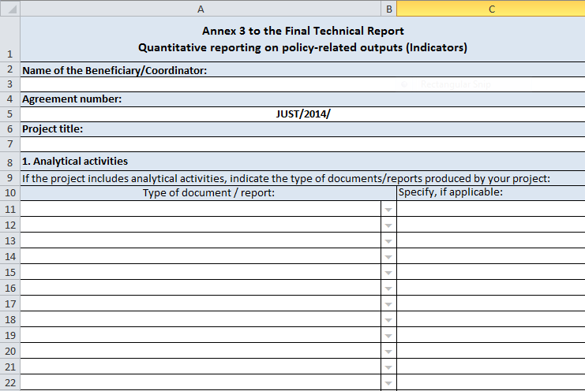
Annex 3: Indicators as an excel sheet available in the Call website

Slide 6
What is the use of this reporting?
It is a Summary presenting the main results of your project in quantitative terms.
The Commission requests from all projects comparable and concise information on their results.
The aim is to measure the performance/results of the respective call for proposals and of the Programme.

Slide 7
How do you fill it out?
Be consistent with the Outputs of your project, as you presented them in detail under the Workstreams.
Be realistic; don’t exaggerate; reflect the actual achievements of your project.
You don’t have to fill out every box!
Fill out ONLY the boxes relevant to your project!

Slide 8
How do you fill it out?
Avoid abbreviations (unless commonly used)!
Be as specific as possible: the information should be clear to persons who haven’t read your project e.g. avoid referring generally to “volunteers”, “experts”, “NGOs”, “researchers”, “professionals”, “other EU States judges and prosecutors”, “participating NGOs”.
4 categories of activities: You should count the results of each activity only once. If you consider that an output meets the criteria of more than one category of activities, you should count it under the category that is most relevant to its objectives.

Slide 9
Category 1: Analytical activities
Reports aiming at the collection of data and statistics, the development of common methodologies on data collection, the development of indicators, benchmarks etc;
Reports aiming at providing research, analysis, evaluation and policy recommendations, etc;
Guides, manuals, handbooks, toolkits, educational material, etc.

Slide 10
Category 1:Analytical activities
COUNT:
Only once each stand-alone & finalised output/deliverable.
DON’T COUNT:
X data collection, analysis of this material and the analysis report = ONE deliverable;
X draft reports;
X Don’t count separately the “tools” to be used for drafting your report (e.g. questionnaires; interview questions; tables and graphs; fiches which will be compiled into a report; agreed methodology for your research; grid to collect data);
X If more partners are drafting parts of one report, you don’t count each contribution as one separate report.

Slide 11
Category 1: Analytical activities
DON’T COUNT:
X Reports for the Commission as foreseen in the Grant Agreement (i.e. Progress report, Final report);
X Documentation for the internal management and implementation of the project (e.g. Plan for the project implementation; report on a partners’ meeting or study visit; Project evaluation);
X Reports on other types of activities (e.g. Conference report, seminar report);
X Training material.

Slide 12
Category 2: Training activities
Number of training events organised;
Groups of professionals and number of persons trained;
Number of training modules developed.

Slide 13
Category 2: Training activities
Training: when a trainer transfers knowledge to a group of persons;
Mutual learning activity: when people come together to learn from each other.
Be specific in defining the group of professionals;
Under training module you should count a specific and practical training package that can be reproduced in more than one events.
DON’T COUNT:
X training limited to project staff;
X a report on a training event should not be counted as a training module.

Slide 14
Category 3: Mutual learning, exchange of good practices, cooperation
Number of events organised;
Groups of professionals and number of persons who participated in these events;
Number of eligible countries involved in these events;
Mechanisms/tools of cross-border cooperation.

Slide 15
Category 3: Mutual learning, exchange of good practices, cooperation
Training: when a trainer transfers knowledge and/or skills to a group of persons;
Mutual learning activity: when people come together to learn from each other;
- Awareness-raising event: when the aim is to provide information to a wider group of persons.

Slide 16
Category 3: Mutual learning, exchange of good practices, cooperation
Mechanism/tool of cross-border cooperation: wide notion.
It should be a long-term and sustainable deliverable to be maintained after the project’s end (such as a network).
(DON’T COUNT: field visits, deliverables counted elsewhere)
It should be concrete and tangible.
(DON’T COUNT: Exchange of knowledge or of best practice)
(DON’T COUNT: Websites =>to be counted under awareness-raising)

Slide 17
Category 4: Awareness-raising,information and dissemination
Events organised (e.g. campaigns, conferences, etc);
Groups of persons and number of persons reached by these events;
Type of materials used (booklets, flyers, websites, etc) and number of copies produced per type of material.

Slide 18
    Thank you for your attention!
    QUESTIONS ? ? ?
DG Justice

