Slide 1

2023 Monitoring report on progress towards the SDGs in an EU context
Christine MAYER – Eurostat, unit E.2
Sustainable Development Goals (SDGs) - monitoring report - 2023 edition – Webinar 25 May 2023

Slide 2



UN SDG indicators (as of February 2022) | EU SDGs indicators (2023 set)
Structured along 17 goals and 169 targets | Structured along 17 goals
231 indicators | 100 indicators; 68 aligned with UN SDG indicators
59% (136 indicators) “ready to use” (tier I internationally established methodology and standards, data regularly produced for at least 50% of countries) | 100% “ready to use”
17 multipurpose indicators | 33 multipurpose indicators
Comprehensive reviews in 2020 and 2025 | Reviewed annually

Slide 3
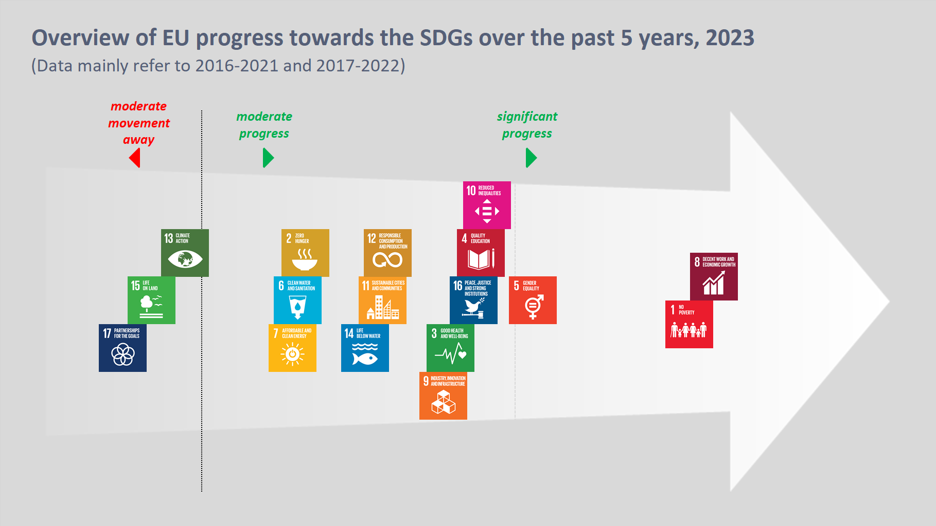

Slide 4
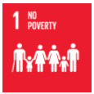
Key results 2023 - best performers
SDG 8 – Decent work and economic growth
Recovery after the pandemic continues - record high employment rate (74.6%) in 2022 – on track to reach 2030 target (78%)
GDP per capita above pre-pandemic level
Share of young people neither in employment nor in education and training at all time low - 2030 target of 9% in reach
SDG 1 – No poverty
Considerable improvement in all poverty dimensions
Fewer people face problems meeting their basic needs
Stronger progress required to lift at least 15 million people out of poverty by 2030
Notes:
In SDG 8 all indicators except material footprint for the short term period show strong progress
Long term trends almost equally positive. EU keeps its promise as a social and economic Union

Slide 5
Key results 2023 – significant progress
SDG 5 – Gender equality
Women’s hourly earnings catching up with those of men
Gender employment gap has narrowed since 2017 but more progress necessary to half the gender employment gap by 2030
In the area of education, gender gap is reversed - men continue to fall further behind women in terms of tertiary education
Growing share of leadership positions held by women

Slide 6
Key results 2023 – good progress
SDG 10 – Reduced inequalities
Income inequalities have decreased, also between urban and rural areas
Continued convergence of Member States in terms of GDP per capita and household income
Better integration of migrants in the labour market
SDG 4 – Quality education
Positive trends in participation in education and training – target for early leavers can be reached but more progress needed for early childhood education
Quality of education and training needs to be improved – there are more low achieving pupils and the share of adults with basic digital skills not growing fast enough

Slide 7

Key results 2023 – good progress
SDG 16 – Peace, justice and strong institutions
Life in the EU has become safer and governments invest more into the justice systems
SDG 3 – Good health and well-being
Overall assessment is impacted by COVID-19 – healthy life years and avoidable mortality rate
Positive trends for other causes of death (work accidents, traffic accidents, …)
SDG 9 – Industry, innovation and infrastructure
Mostly favourable trends except for the share of sustainable and environmental friendly modes of transport.

Slide 8
Key results 2023 – moderate progress
Notes:
Slow progress of SDG 7 the result of the new, very ambitious targets for energy efficiency and renewable energies

Slide 9
Key results 2023 – more progress necessary
SDG 13 – Climate action
Greenhouse gas emissions reduced by 30% compared to 1990
Based on past trends more effort required to meet the very ambitious reduction targets set for 2030.
Additional measures have been already put in place as part of the ‘Fit for 55 package’.
Climate related economic losses have risen sharply in 2021 due to extreme weather events.
EU’s contribution to the 100bn$ target continues to increase.

Slide 10

Key results 2023 – more progress necessary
SDG 15 – Life on land
Forest area and terrestrial protected areas increased slightly.
Pressures on biodiversity continue to affect ecosystems and more effort needed to reverse degradation of land and biodiversity
SDG 17 – Partnerships for the goals
Imports from developing countries have grown
EU’s official development assistance has fallen
Public debt levels have increased as a result of public spending to cushion the effects of COVID-19

Slide 11
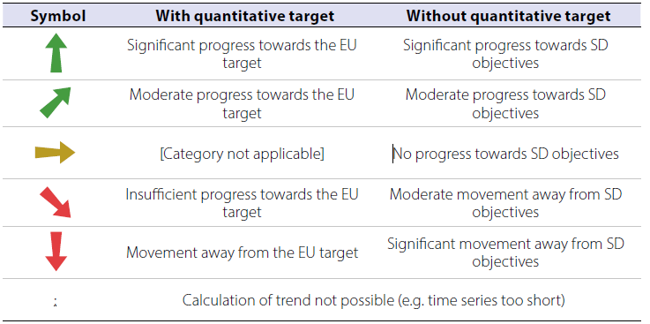
Trend assessment methodology
Assessment of individual indicator trends…
  …with an existing quantitative policy target:
  „Is the EU on track to reach the target?“
  …without a quantitative target:
  „Is the EU moving in the right direction with
  regards to…?“

Slide 12
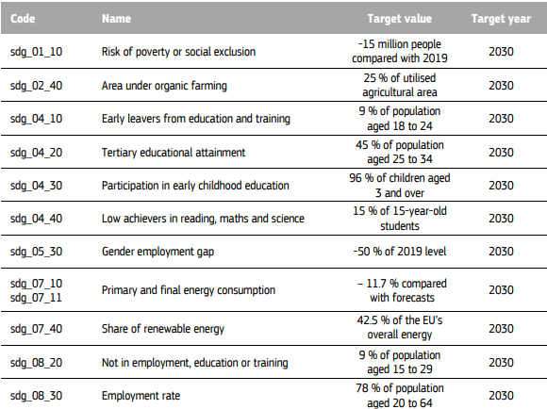
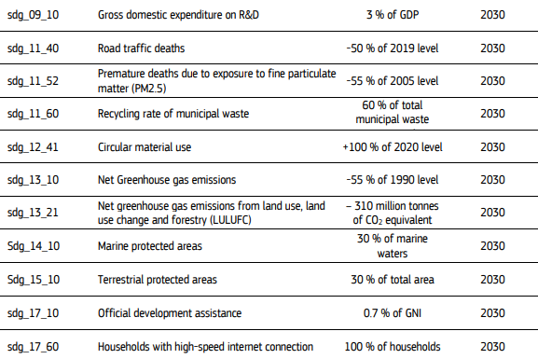
Indicators assessed against quantitative targets

Slide 13
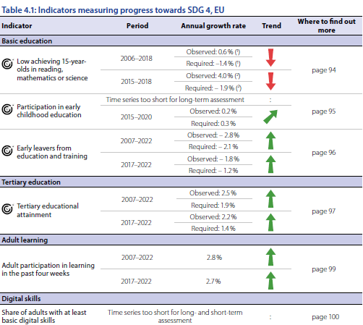
Indicator assessment – example

Slide 14
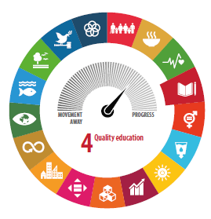
Indicator assessment – example

Slide 15
Summary of assessment trends
Long term assessment
Short term assessment
Almost three quarters of all assessed indicators show positive developments

Slide 16
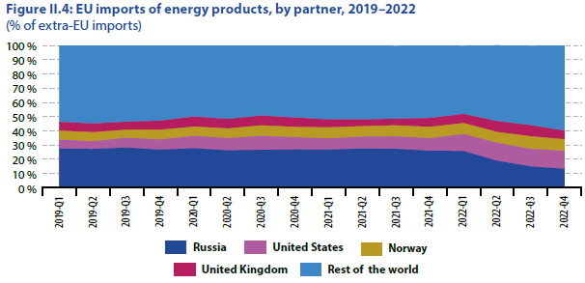
Short term chapter
Impact of Russia’s invasion of Ukraine and aftershocks of the pandemic on SDGs

Slide 17
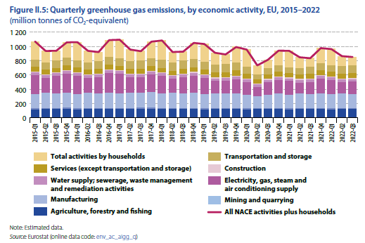
Short term chapter
Impact of Russia’s invasion of Ukraine and aftershocks of the pandemic on SDGs

Slide 18
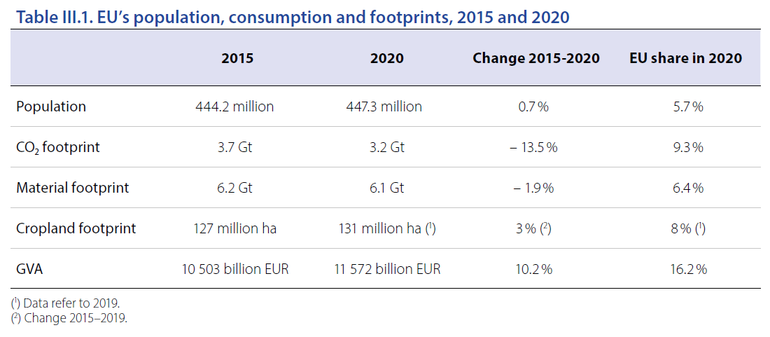
Assessment of spillover effects
The impacts that activities in country have on other countries are called spillover effects.

Slide 19
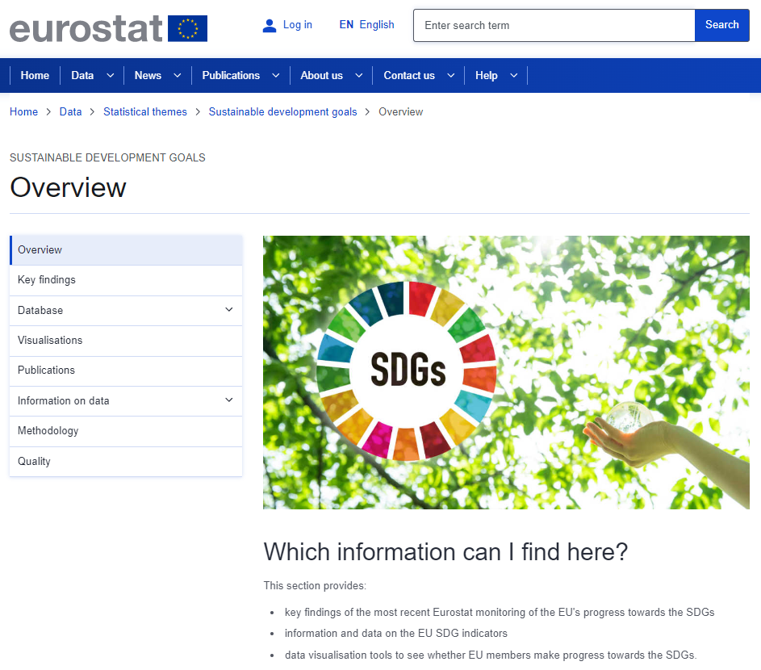
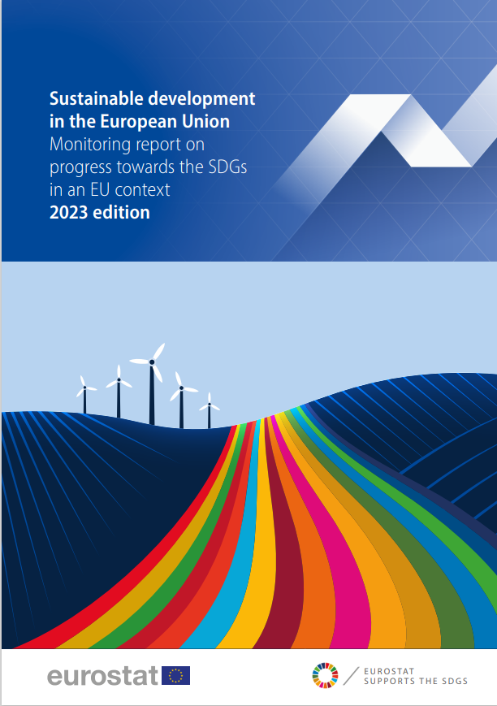
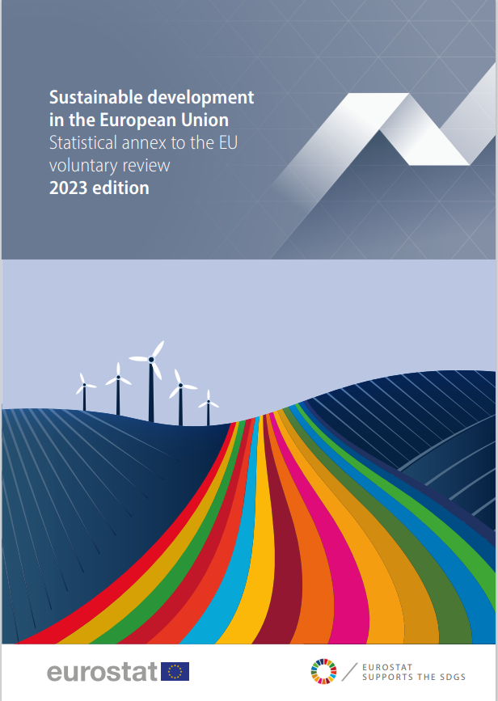
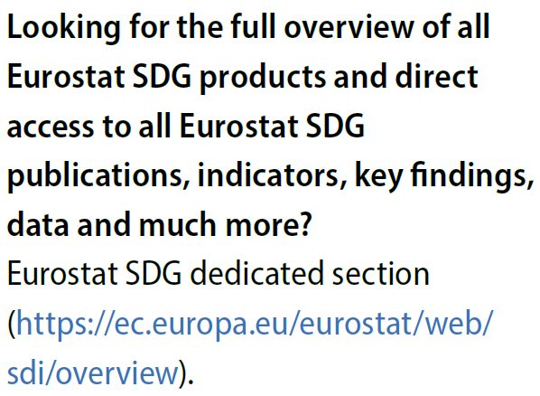
Communication package

Slide 20

Thank you
Overview - Sustainable development indicators - Eurostat (europa.eu)
Contact ESTAT-SDG-MONITORING@ec.europa.eu
© European Union 2023
Unless otherwise noted the reuse of this presentation is authorised under the CC BY 4.0 license. For any use or reproduction of elements that are not owned by the EU, permission may need to be sought directly from the respective right holders.

