Slide 1
Eurostat webinar on Macroeconomic Statistics
Nicola Massarelli, Eurostat, National Accounts Methodology (nicola.massarelli@ec.europa.eu)
Robert Leisch, Eurostat, Balance of Payments
(robert.leisch@ec.europa.eu)
4 December 2023

Slide 2
Introduction: National Accounts (NA) and Balance of Payments (BOP) today
NA are a complete and consistent system of accounts and balance sheets, providing an integrated framework to describe economic interactions between entities of an economy (whether a region, a country, or a group of countries such as the European Union)
BOP captures all transactions between resident entities of one economy with residents of the rest of the world
NA and BOP provide information to analyse the structure of economies and their development over time.
Two main characteristics of NA and BOP:
  consistent bookkeeping system
  and based on macroeconomic theory

Slide 3
NA and BOP: general idea
General idea: faithfully represent the trillions of activities in the economy in a period of time
For NA, production is the source of value (production approach). Value is distributed to recipients (income approach), and then spent or saved (expenditure approach)
Financial instruments act as mediums of exchange and stores of wealth
In BOP, transactions related to non-financial assets (goods, services) and income based on financial assets (bonds, shares, loans,…) are recorded in the current and the capital accounts and transactions involving financial assets in the financial account
A surplus in the current and in the capital accounts indicates a lending of an economy vis-a-vis the rest of the world during a specific period
GDP = C + G + I + (X-M)
Notes:
As I said at the beginning, National accounts are a complete and consistent system of accounts and balance sheets, providing an integrated framework to describe an economy.
NA are supposed to show us what happens in an economy. An economy is extremely complex. Trillions of individual activities are involved, lots of interactions, some involving money, some not.
How can this incredible complexity be distilled in something that is relatively simple and be shown to a politician?
Doing so requires a very simple and logical structure.
In national accounts we follow the simple idea that:
Production is the source of value in the economy. There are also other reasons why overall wealth may change (eg. revaluations), but they are considered separately.
The value from production is distributed to recipients – one might call this the typical factor incomes (wages, interest on loans, tax).
Then the value is spent or saved (and then used for investment).
It’s important to distinguish between a financial and a non-financial part here. The non-financial part has to do with the production of goods, wages, revenues, etc.
You may think at the financial side of the economy as the oil that lubricates the economic system, which helps the economy to work in a more efficient way.
Financial instruments are not creators of value in themselves, rather that act as:
mediums of exchange (otherwise we would need to barter good and services for other goods and services)
and of course stores of wealth (alongside non-financial assets).
Thus you will quite often hear about “national accounts” and “financial accounts” spoken about separately, even if they’re part of the same system.

Slide 4
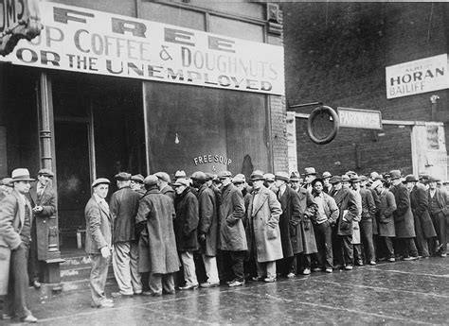


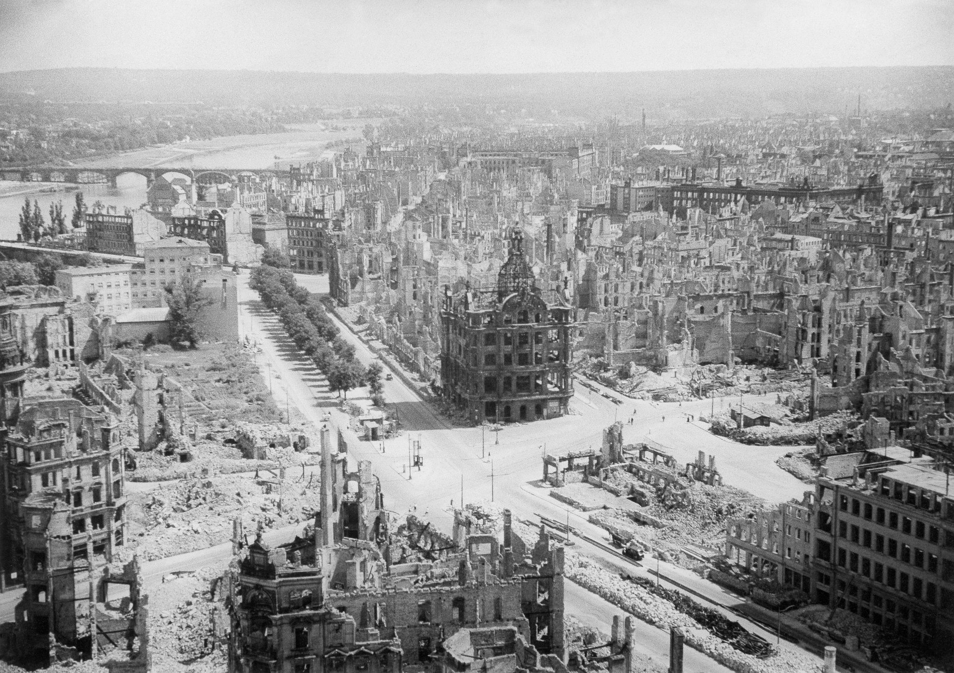





Slide 5
Statistical domains are complementary
Macroecnomic statistics
Population
& Social
Statistics
Environmental Statistics & Accounts

Slide 6
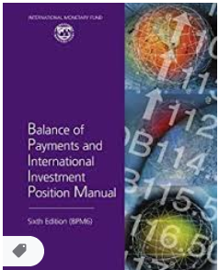
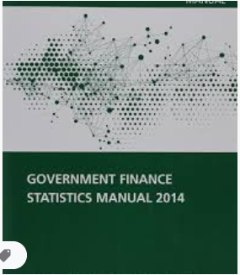

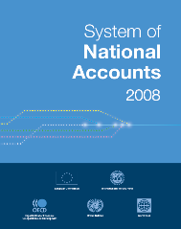
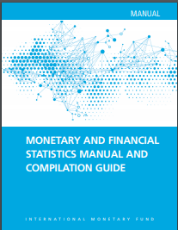

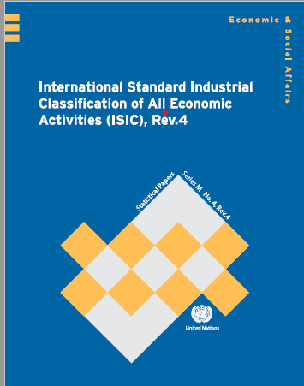
The System of National Accounts (SNA)
The Balance of Payments Manual (BPM)
Internationally agreed standards for National Accounts and Balance of Payments compilation
Intended for use by all countries (at different stages of economic development)
An overarching framework for standards in other domains of economic statistics, facilitating the integration
System of National Accounts
Balance of Payments
System of Environmental Economic Accounts – central framework
System of Environmental Economic Accounts – ecosystem accounting
Monetary and financial statistics
Government finance statistics
Activity and product classifications

Slide 7
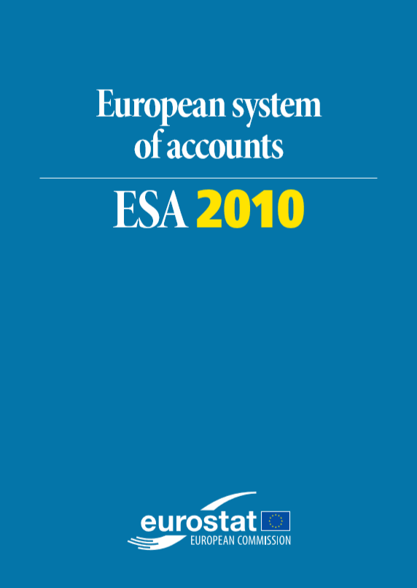
ESA 2010 – Europe’s standards
‘ESA 2010’ largely consistent with SNA 2008
  From Sept 2014 (ESA95 before)
Legal Regulation
Administrative uses (amongst others)
  Excessive Deficit Procedure (EDP)
  EU Budget (Fourth Resource)
  Structural Funds
Notes:
As I mentioned before, in Europe we have translated the SNA into our own standard – ESA. Currently we have ESA 2010.
ESA2010 is largely consistent with the 2008 SNA, as it should be for international comparability. We don’t want to diverge from the international standards, so that we can compare European GDP with US or Japan’s GDP. This is what users want. The main differences are in classifications and certain specific operational rules which we felt necessary to assure harmonisation inside Europe. The 2008 SNA is actually a better read, even if longer – you can find it on the UN website.
It’s important to realise that ESA 2010 is actually a legal regulation. Thus to change a single line of our manual we have to go through the torturous process of a Council and Parliament Regulation. Why did we do this?
Mainly because it’s not just macroeconomic forecasters who need national accounts data. It’s also used for European administrative purposes. Here are three examples of “administrative” use of NA data in Europe, which require the highest possible comparability, which can be achieved only by enforcing common rules:
For the Excessive Deficit Procedure, the procedure by which The European Commission reviews Member States’ compliance with the deficit and debt criteria of the Treaty.
To estimate “Gross National Income”, which is the basis for over 70% of Member States’ contributions to the EU budget.
And for regional data: the poorer regions in Europe have access to structural funds, and regional NA data are used to check regions’ eligibility criteria.
So we have every incentive to get national accounts fully harmonised in Europe, and we need a legal basis to oblige countries to follow common standards!

Slide 8
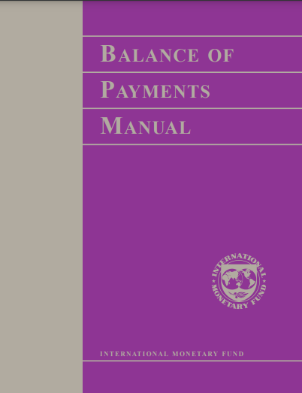
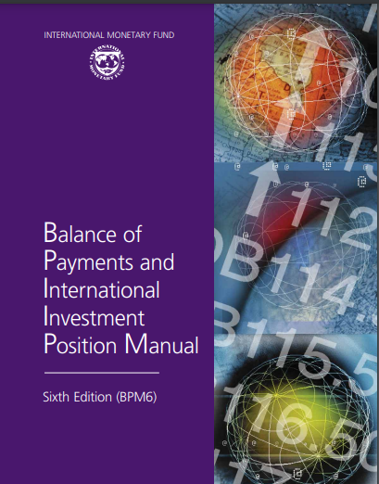
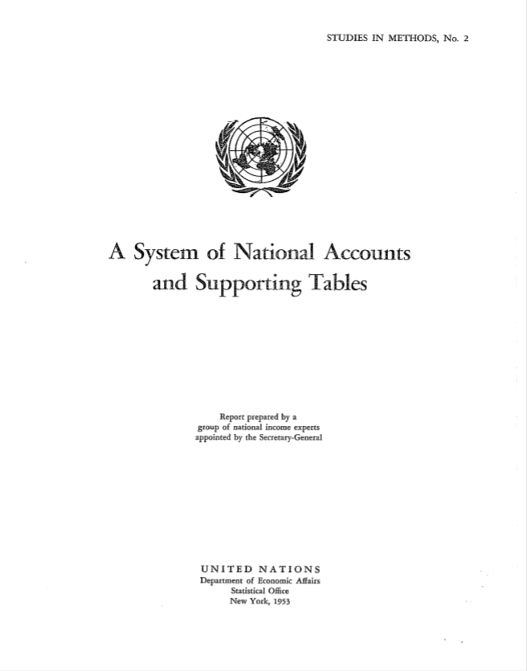

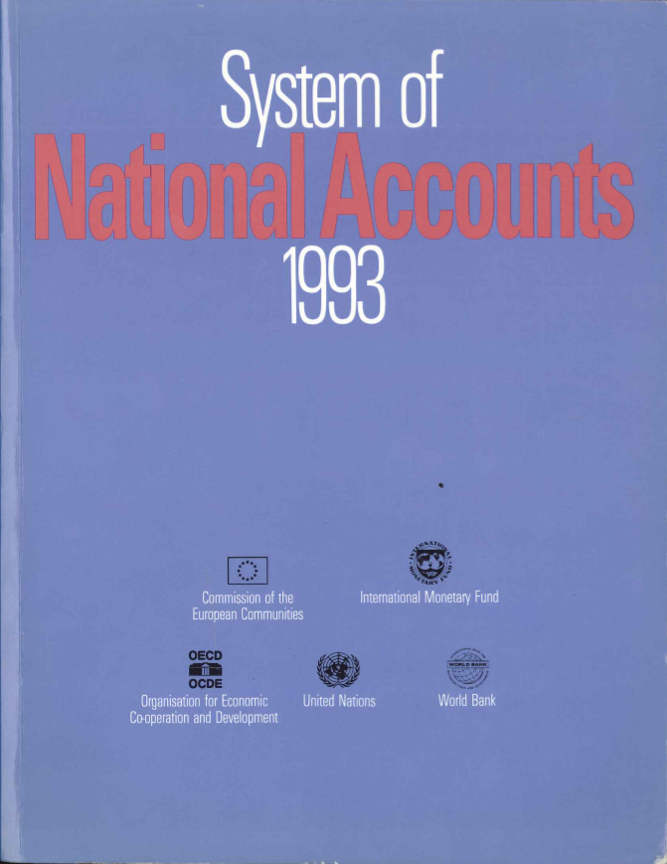
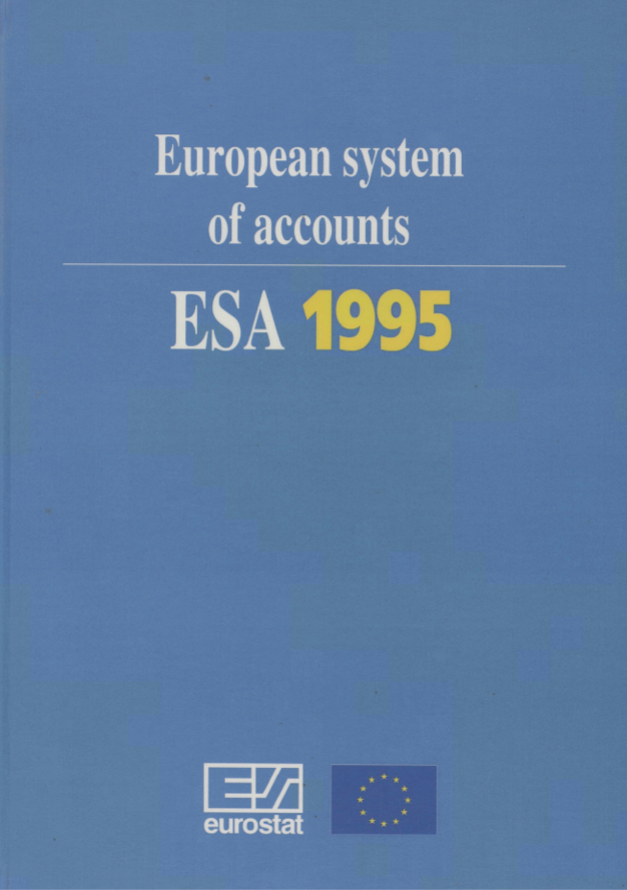
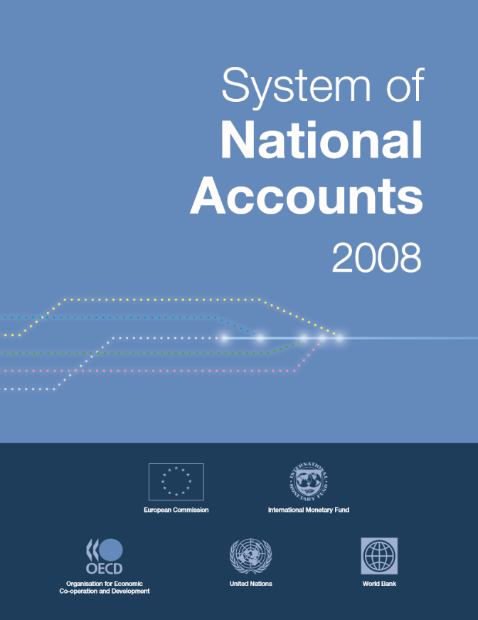
SNA/BPM and ESA updated roughly every 15 years
BPM7
SNA
2025
ESA
202?
1953
1968
1993
2008
2025
Macroeconomic accounting standards are regularly updated to reflect changes in the economy
1993
2008
2025

Slide 9
SNA & BPM update: Milestones
UNSC and BOPCOM
launch update process
Conceptual development of research topics
Global consultation on complete list of recommen-dations
UNSC approves
recommen-dations
Global consultation on complete draft 2025 SNA and BPM7
UNSC and BOPCOM adopt
2025 SNA and BPM7
Mar. 2020
2020-2023
Aug.-Sep. 2023
Mar. 2024
Mid-2024
Mar. 2025
Iterative drafting of 2025 SNA and BPM7
Early implementation work
PAST
Countries’ tests and
experimental estimates
Development of compilation handbooks on:
Data assets
Marketing assets
Natural capital
Crypto assets
ONGOING
FUTURE

Slide 10






Many actors involved in the update process
STATISTICIANS
Other thematic groups
GFS Advisory Committee
Inter-Secretariat
Working Group on National Accounts:
International organisations
USERS
EG on classifications
Advisory Expert Group (AEG):
International organisations
and country experts
CEBTS
UN CEEA
BOPCOM
Thematic
Task Teams

Slide 11
Thematic Task Teams
Workstreams are organized by Task Teams, led by country members of the AEG/BOPCOM. International organisations provide secretariat
Over 300 experts across Task Teams
Cooperation
Consistency
Joint priority areas
BPM
priority areas
SNA
priority areas
Globalization
Financial
Issues
IPP
BOP
Digitalization
Islamic
Finance
Informal
Economy
Current
Account
Wellbeing and
Sustainability
Communication
Statistical
Units
Classifications
Direct
Investment

Slide 12
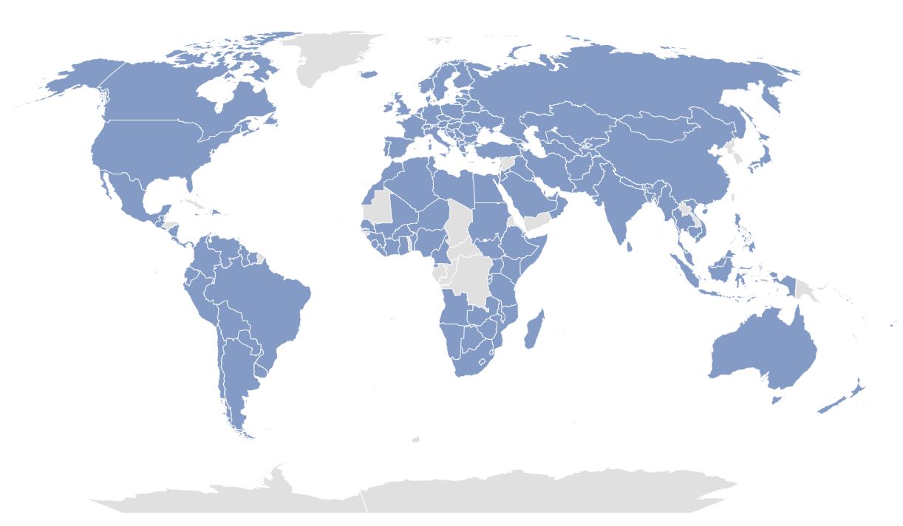
SNA and BPM update: an inclusive process
Worldwide participation in SNA/BPM Global Consultations: about 180 economies have participated in at least one of them
Courtesy of Peter van de Ven

Slide 13
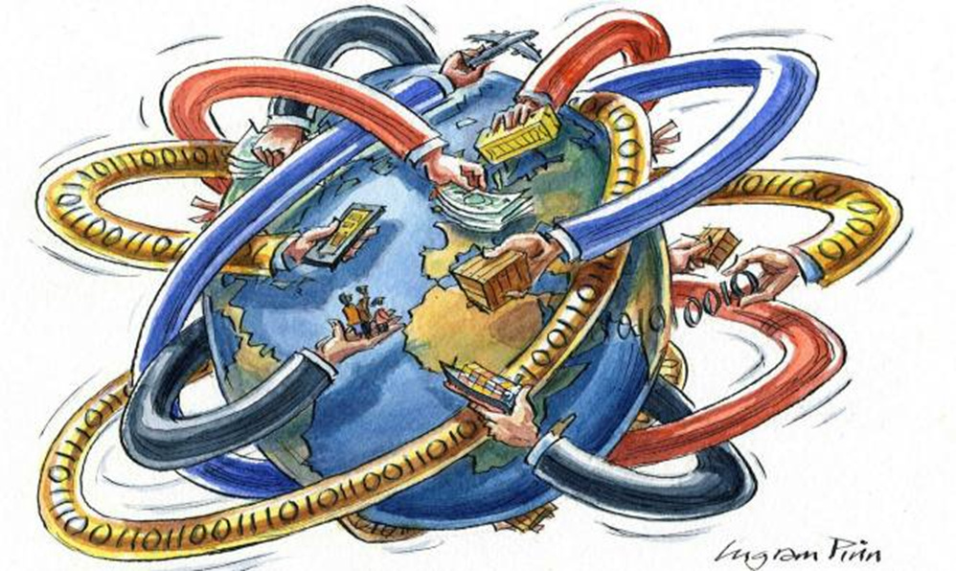






SNA & BPM update: priority areas
Globalisation
Digitalisation
Wellbeing and
sustainability
Communication

Slide 14
Globalization
    Increased focus on structure and activities of Multinational Enterprise Groups (MNEs)
      Goods, Services, and Investment Income by Enterprise Characteristics
      Clarification on recording of intellectual property products within MNEs
      Separate information on Special Purpose Entities (SPEs), as an “of which” item for corporations
    New treatment of Marketing Assets (trademarks, logos)
    More detailed information on Factory-less Good Production Arrangements and clarification for the treatment of digital platforms
    A more detailed breakdown for Trade in Services

Slide 15

Communication
    Work on “Terminology and Branding”: effort to make the language less technical and more user-friendly
    Development of a common glossary for macroeconomic statistics
    (beyond just SNA and BPM)
    Assessment framework to measure country alignment with the standards

Slide 16

Digitalization
    Framework to measure the digital economy
    (Digital supply and use tables)
    Recording of data in the national accounts
    Artificial Intelligence
    Cloud computing
    Digital intermediation platforms
    Crypto assets
    “Free” digital products
    Non-fungible tokens
    Fintech and other financial innovations
Courtesy of Peter van de Ven

Slide 17

Main proposals on
A broader SNA framework for Wellbeing and Sustainability
Distributions of household Income, Consumption and Wealth
Supplementary accounts on specific topics:
  Labour accounts
  Human capital and education
  Health care
  Unpaid Household service work

Slide 18
Main proposals on
Depletion of natural resources as cost of production reducing (net) Domestic Product
More prominence to ‘NET’ measures
Natural assets as a separate group of assets, alongside produced and (other) non-produced assets
Renewable energy resources as a new asset class
Distinction of specific types of natural assets
Clarification on the recording of Emission permits

Slide 19
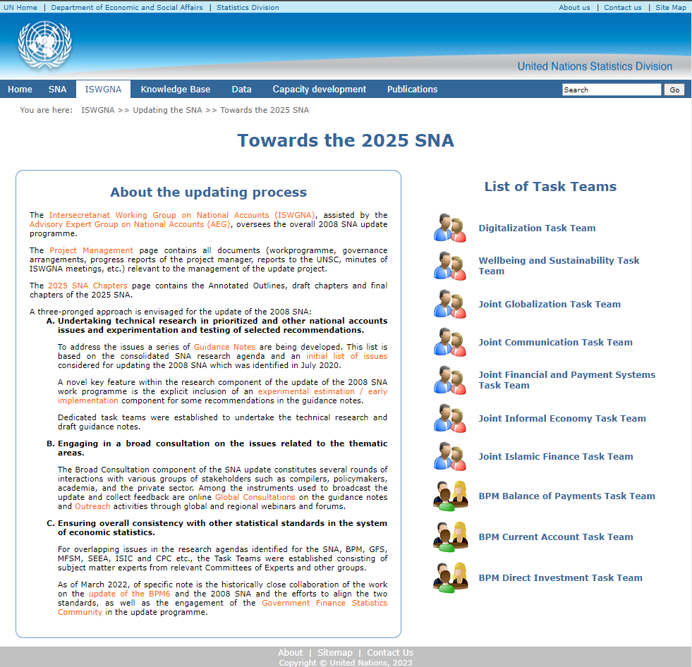
SNA/BPM update websites
SNA update homepage
https://unstats.un.org/unsd/nationalaccount/sna.asp
Full list of guidance notes
https://unstats.un.org/unsd/nationalaccount/SNAUpdate/GuidanceNotes.asp
AEG meetings
https://unstats.un.org/unsd/nationalaccount/ramtg.asp?fType=2
IMF BPM6 update
https://www.imf.org/en/Data/Statistics/BPM

