Slide 1
Unemployment Statistics in the EU
9. November 2023

Slide 2
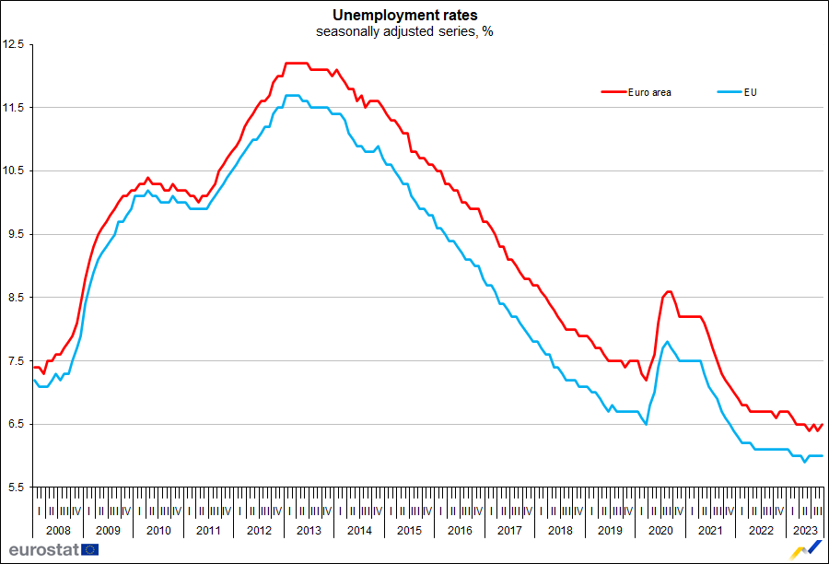
Evolution of unemployment in the EU
The unemployed comprise persons aged 15-74 years who:
are without work;
are available to start working within the next 2 weeks;
have actively sought work within the past 4 weeks.

Slide 3
Unemployment data sources
The Labour Force Survey (LFS)
Monthly, quarterly and annual extractions
EU wide household survey
Over 100 variables; sample size: ~ 1.7 million individuals
Results published by Eurostat for 34 participating countries
Register Data
Monthly data extractions from the registers
Registered unemployment data
LFS is the basis for the EU's monthly unemployment rate, one of Eurostat’s key short-term indicators

Slide 4
Monthly unemployment
One of the Principal European Economic Indicators (PEEIs)
Produced on the basis of LFS data in the EU, sometimes in combination with monthly register data as auxiliary information
Seasonally Adjusted data series: comparable from one period to the next
Can be subject to revisions due to:
fine-tuning of the data modelling
inclusion of most recent LFS data in the calculation process

Slide 5
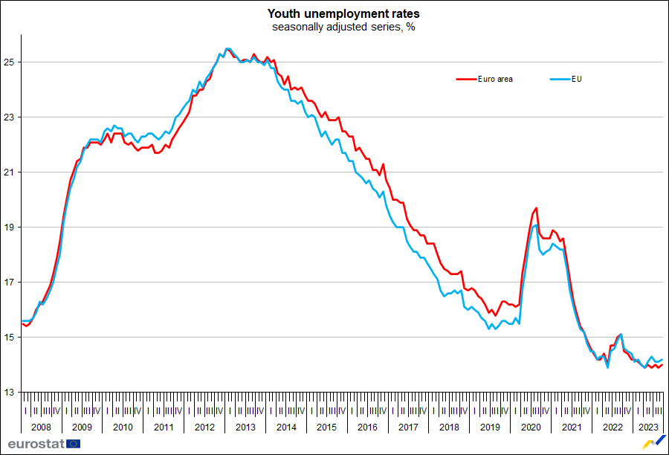
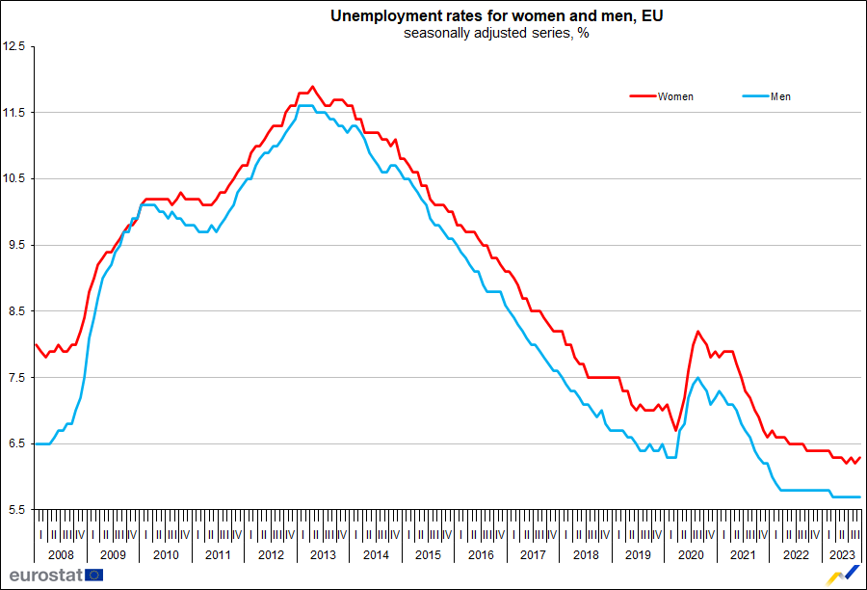
Monthly unemployment by youth and gender

Slide 6
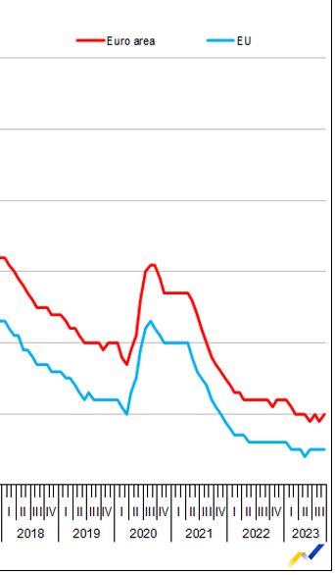
The Covid-19 effect in the data
Sharp increase in the number of claims for unemployment benefits across the EU in March 2020
Already registered no longer actively looking for a job, e.g. limited by the confinement measures or no longer available for work
Decreasing since spring 2021

Slide 7
Unemployment of refugees from Ukraine
Voluntary data collection of registered labour market data on refugees from Ukraine beneficiary of temporary protection
Purely register-based unemployment data
Countries' definitions may differ
Refugees from Ukraine beneficiary of temporary protection living in a sampled household are included in the LFS, independently from the intention of the refugees to stay in the reporting country

Slide 8
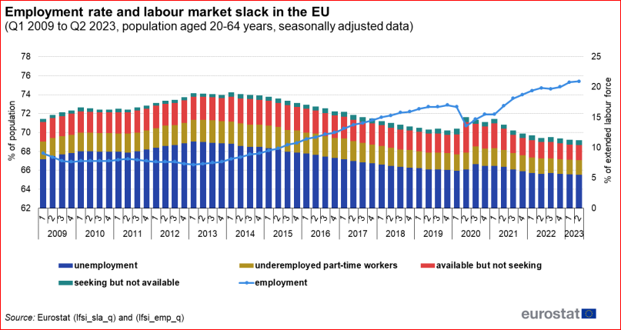
Unemployment and Labour Market Slack

Slide 9
Focus on Countries

Slide 10
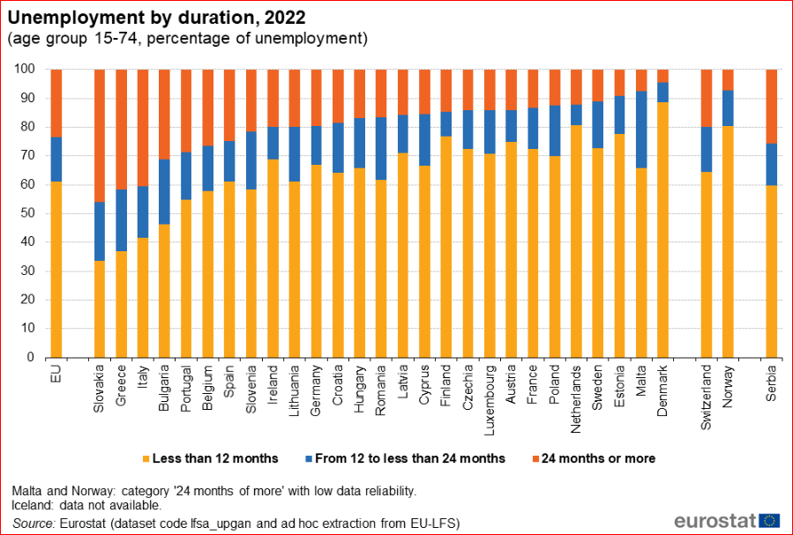
Duration of Unemployment

Slide 11
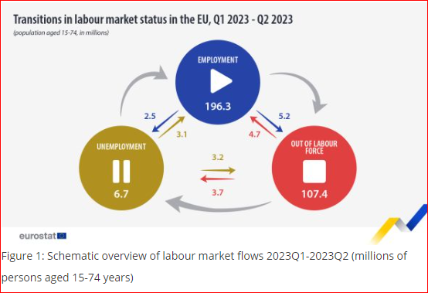
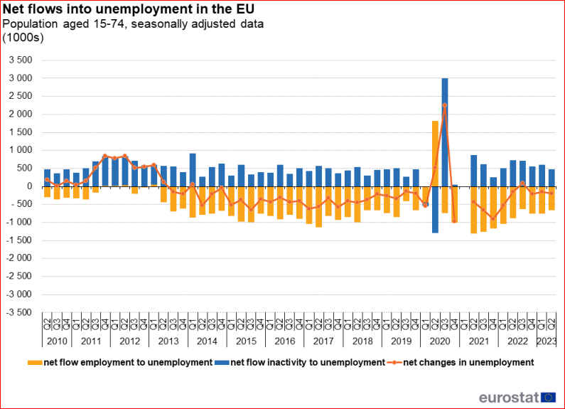
Transitions from / to Unemployment

Slide 12
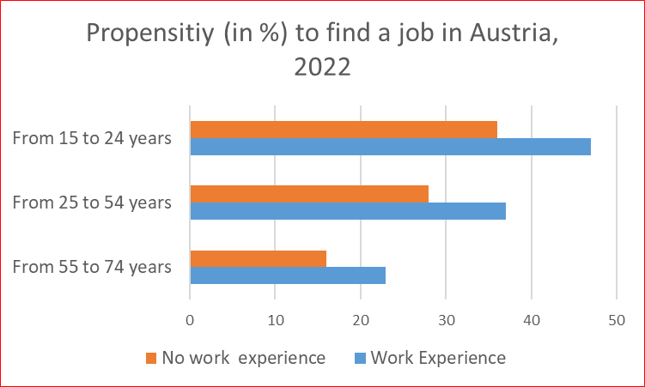
Estimated probabilities – Experimental statistics
From unemployment to employment by age and previous work experience – annual averages

Slide 13
Unemployment and Main Indicators tables

Slide 14
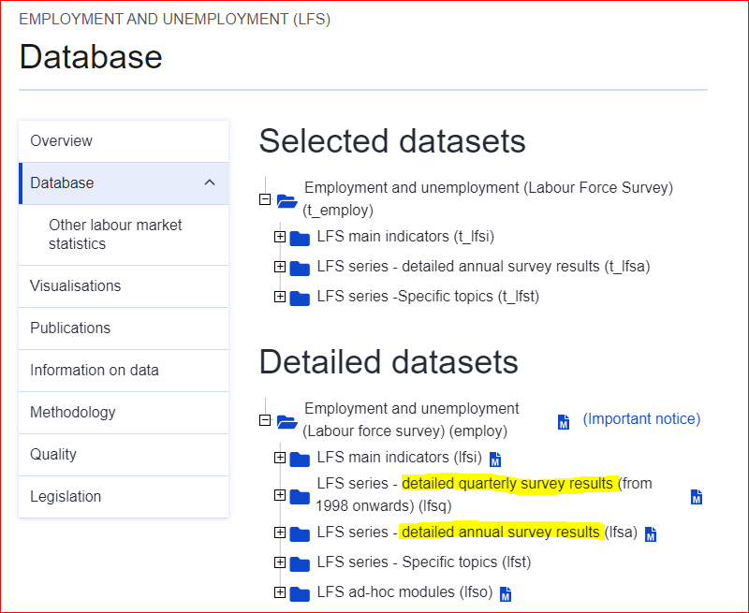
Unemployment and Detailed Survey Results

Slide 15
Links to relevant articles
Unemployment statistics - Statistics Explained (europa.eu)
EU labour market - quarterly statistics - Statistics Explained (europa.eu)
Labour market flow statistics in the EU - Statistics Explained (europa.eu)
Labour market slack - employment supply and demand mismatch - Statistics Explained (europa.eu)
Labour market statistics at regional level - Statistics Explained (europa.eu)
Job vacancy statistics - Statistics Explained (europa.eu)

Slide 16
Thank you
© European Union 2020
Unless otherwise noted the reuse of this presentation is authorised under the CC BY 4.0 license. For any use or reproduction of elements that are not owned by the EU, permission may need to be sought directly from the respective right holders.
Notes:
Update/add/delete parts of the copy right notice where appropriate.
More information: https://myintracomm.ec.europa.eu/corp/intellectual-property/Documents/2019_Reuse-guidelines%28CC-BY%29.pdf

