Slide 1
Eurostat Webinar on Job skills
27 October 2023

Slide 2
I. Job skills from the perspective of occupations, level and field of education
Source: EU Labour force survey
Dilyan Atanasov

Slide 3
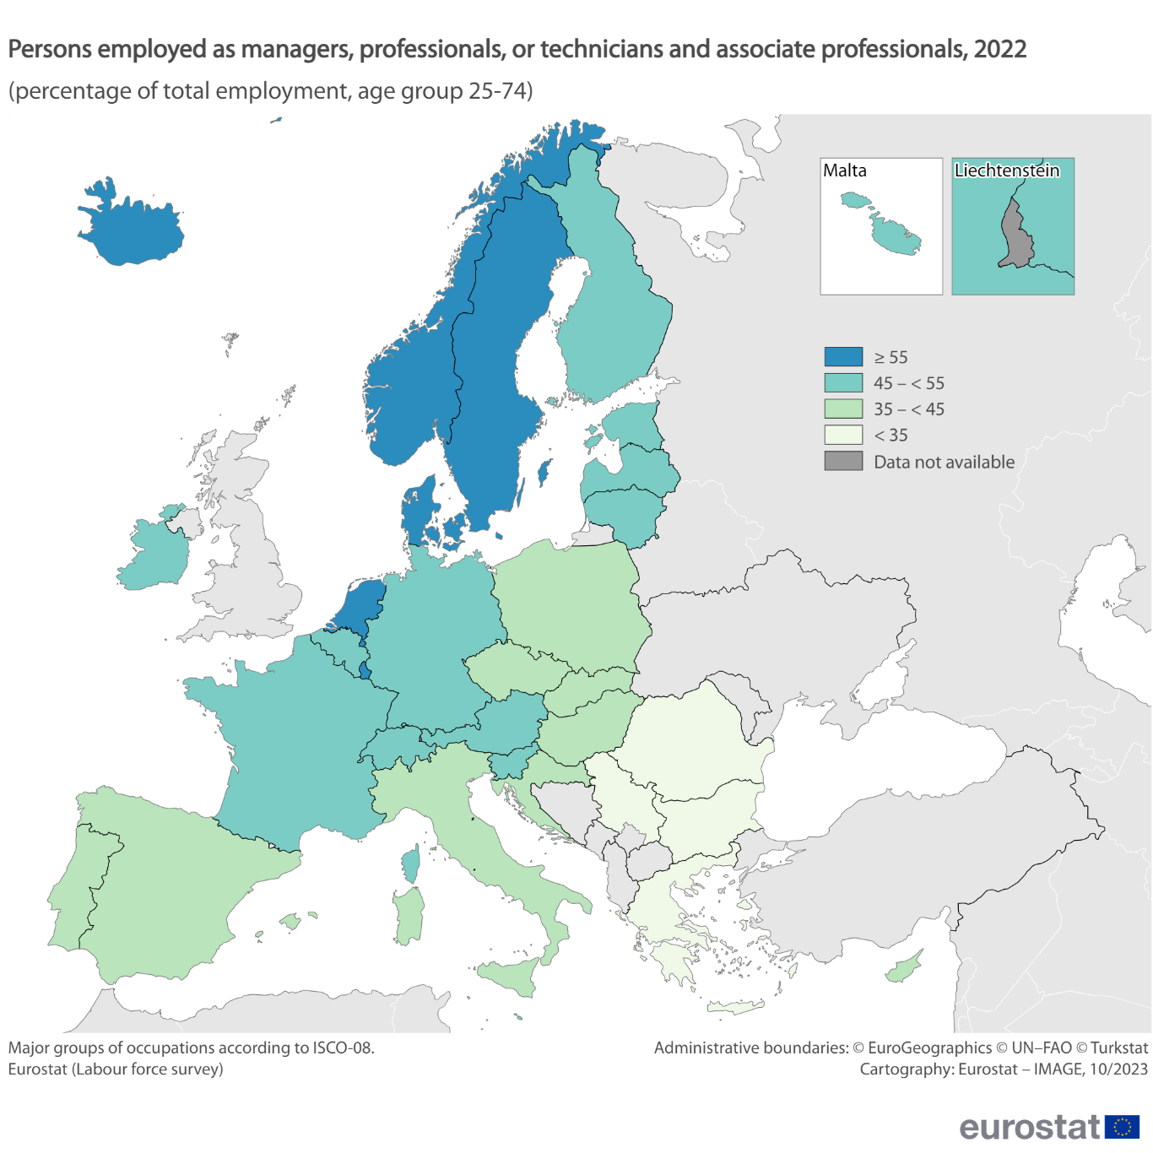
Highly skilled employment based on the occupation
44% of EU employment was highly skilled in 2022
Bulgaria, Greece, and Romania had the shares < 35%
Luxembourg, Sweden, the Netherlands, and Denmark ≥ 55%

Slide 4
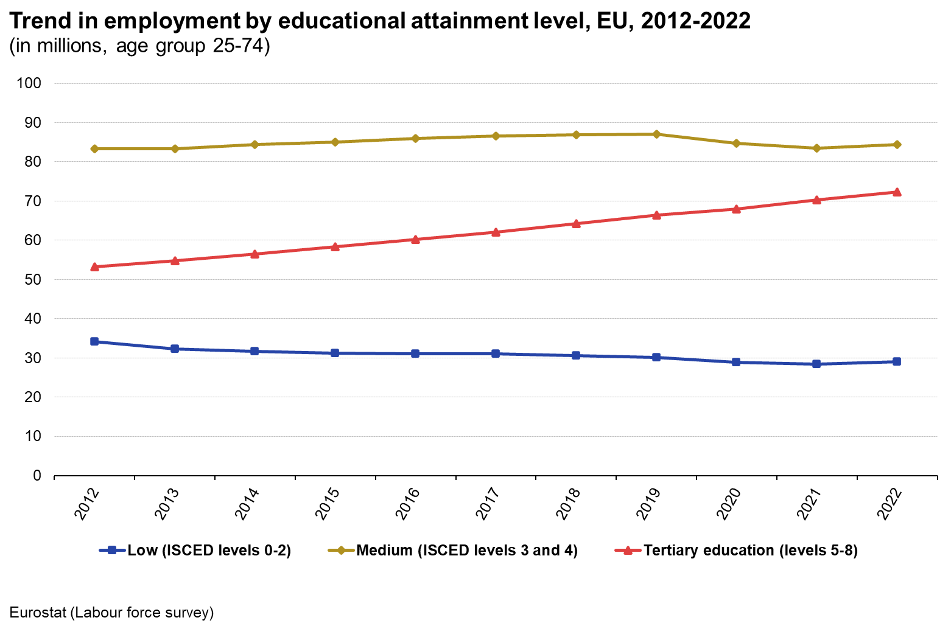
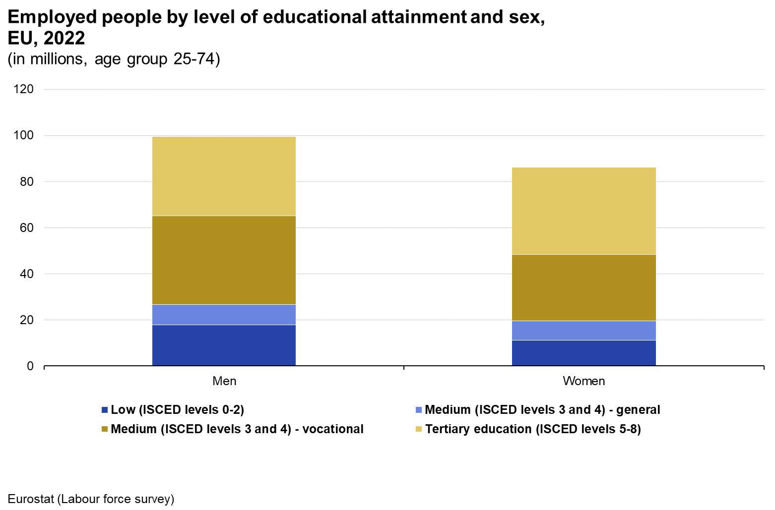
More people with a high level of education
Low level of education down 15% over 2012-2022
Medium level of education relatively stable
Tertiary education up 36%
Employment with tertiary education: 35% among men and 44% among women in 2022
Employment with medium vocational education: 39% among men and 33% among women

Slide 5
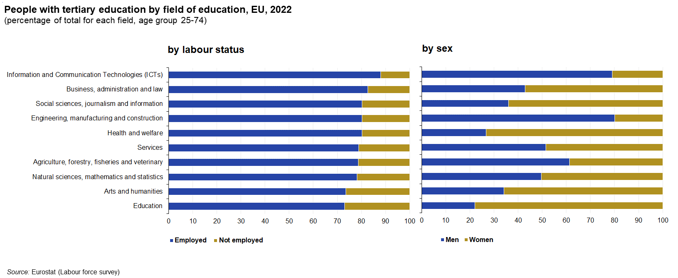
What about the field of education?

Slide 6
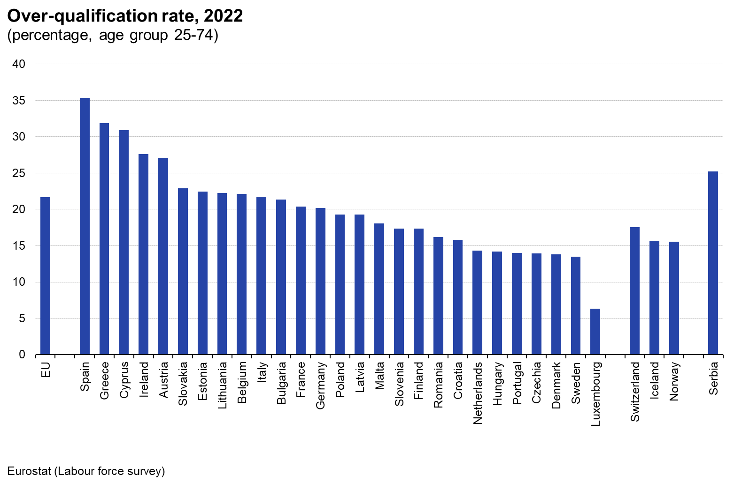
What is overqualification rate?
Highest rates in Spain, Greece, and Cyprus
Lowest rates in Luxembourg, Sweden, Denmark, and Czechia
The proportion of employed individuals with tertiary education working in occupations where such a high level of education is not required

Slide 7
Measuring Digital Skills in the EU
Data from the EU survey on the use of ICT in households and by individuals
Andrea ATTWENGER

Slide 8
Digital Skills Indicator
based on the Digital Competence Framework for Citizens (DigComp)
5 dimensions with several component activities each
Digital Decade Key Performance Indicator (until 2030): 80% of the EU population with at least basic digital skills
“at least basic” = at least one activity per dimension
Communication and collaboration
e.g. e-mails, instant messaging
Information and data literacy
e.g. finding information, fact checking
Problem solving
e.g. online learning, changing software settings
Digital content creation
e.g. using Word or Excel, writing code
Safety
e.g. managing access to personal data, changing cookie settings

Slide 9
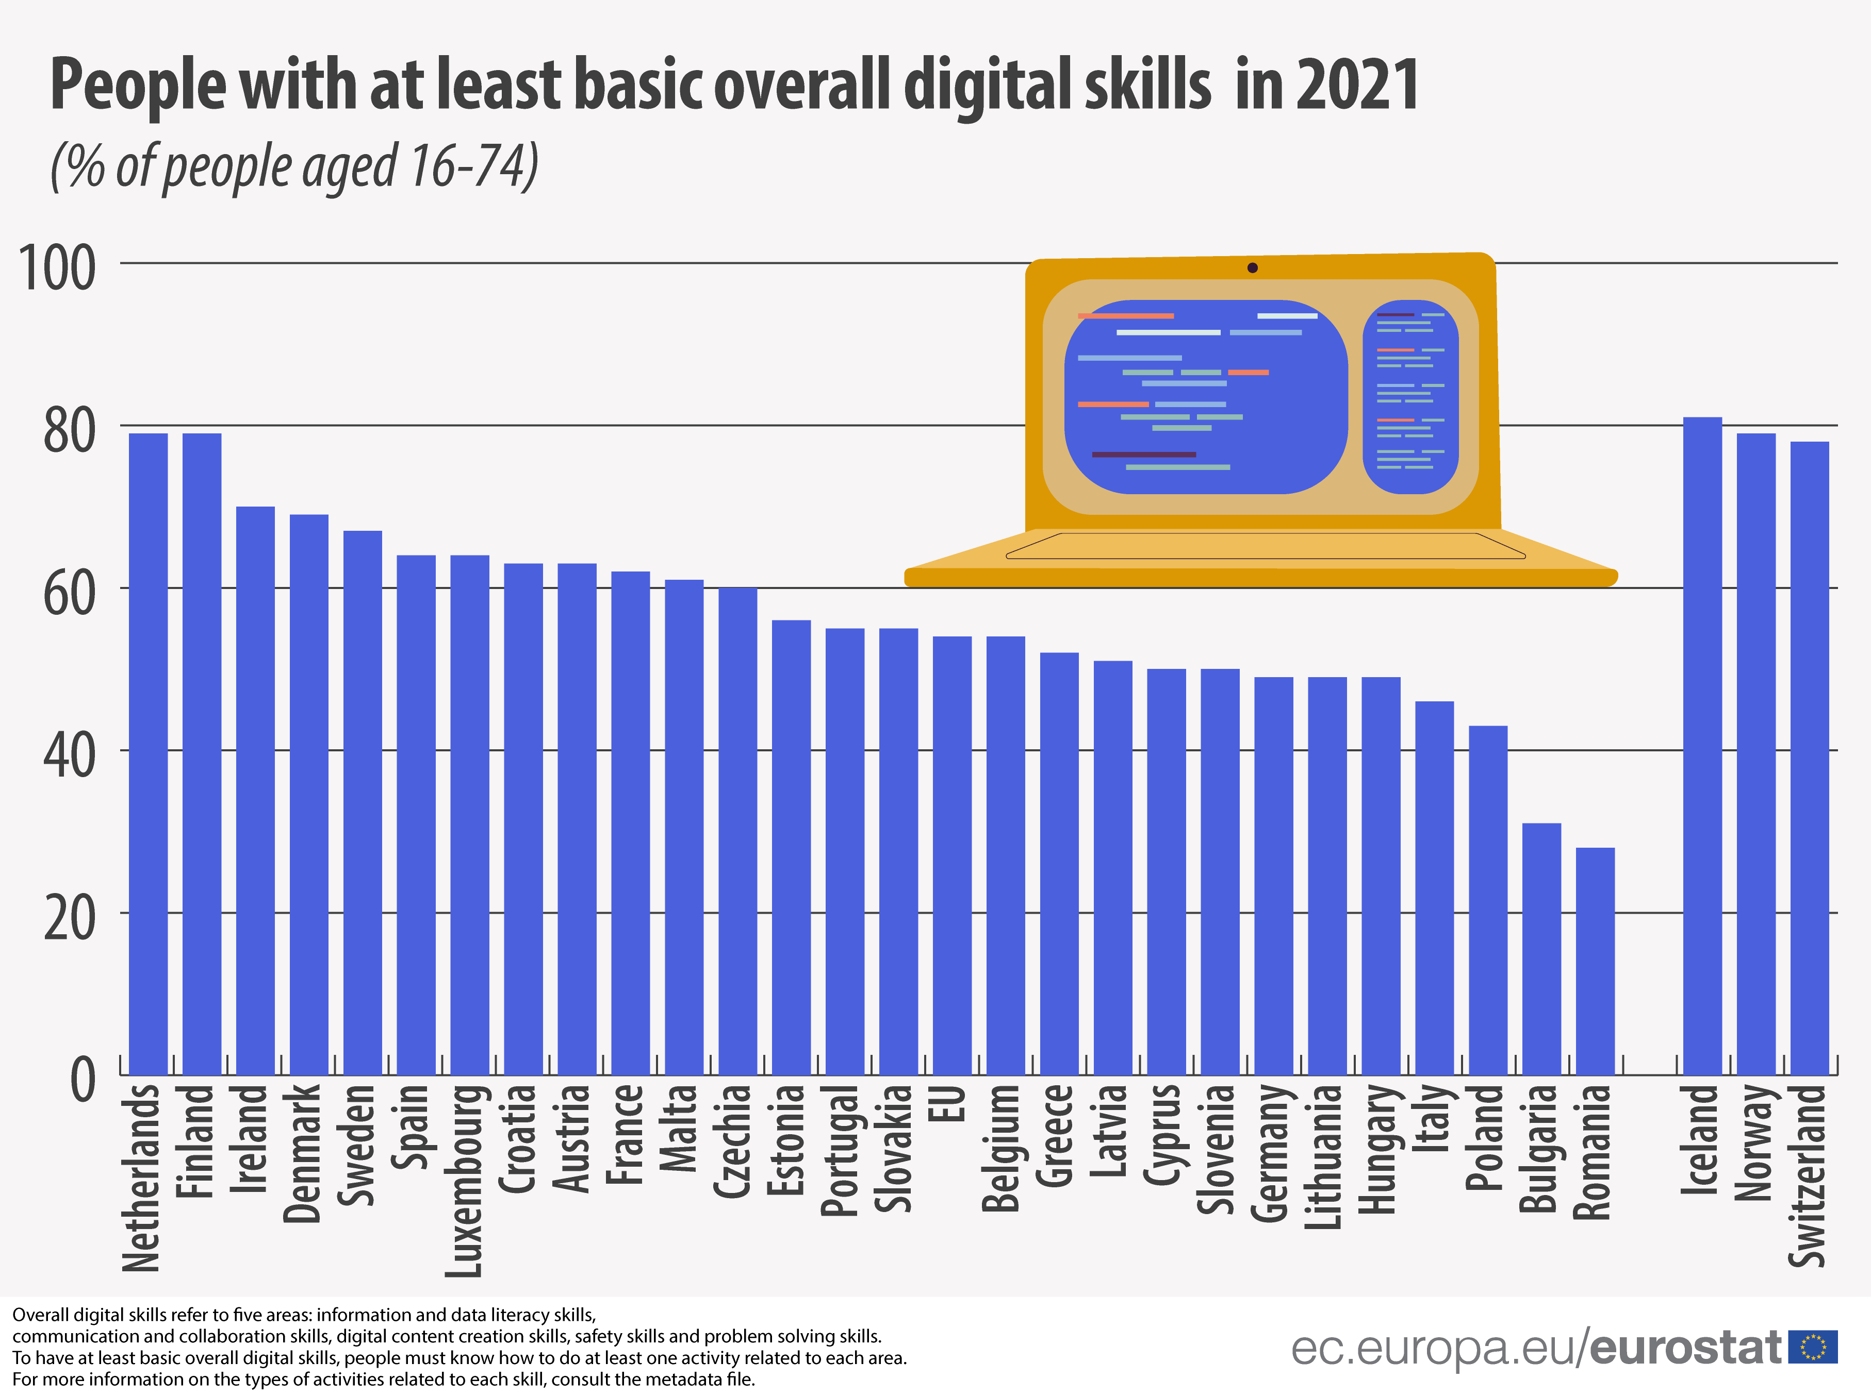
2023 data coming in December
80% with at least basic digital skills

Slide 10
Digital Skills Divide
People with at least basic digital skills…
80% target
54%
79% 32%
71% 35%
61% 46%
individuals aged 16-74
with high formal education with low or no formal education
aged 16-29 aged 55-74
living in cities living in rural areas

Slide 11
Measuring Skills Utilization in the EU
Data from the EU Labour force survey ad-hoc module on Job Skills
Sabrina Iannazzone

Slide 12
Working time spent using digital devices

Slide 13
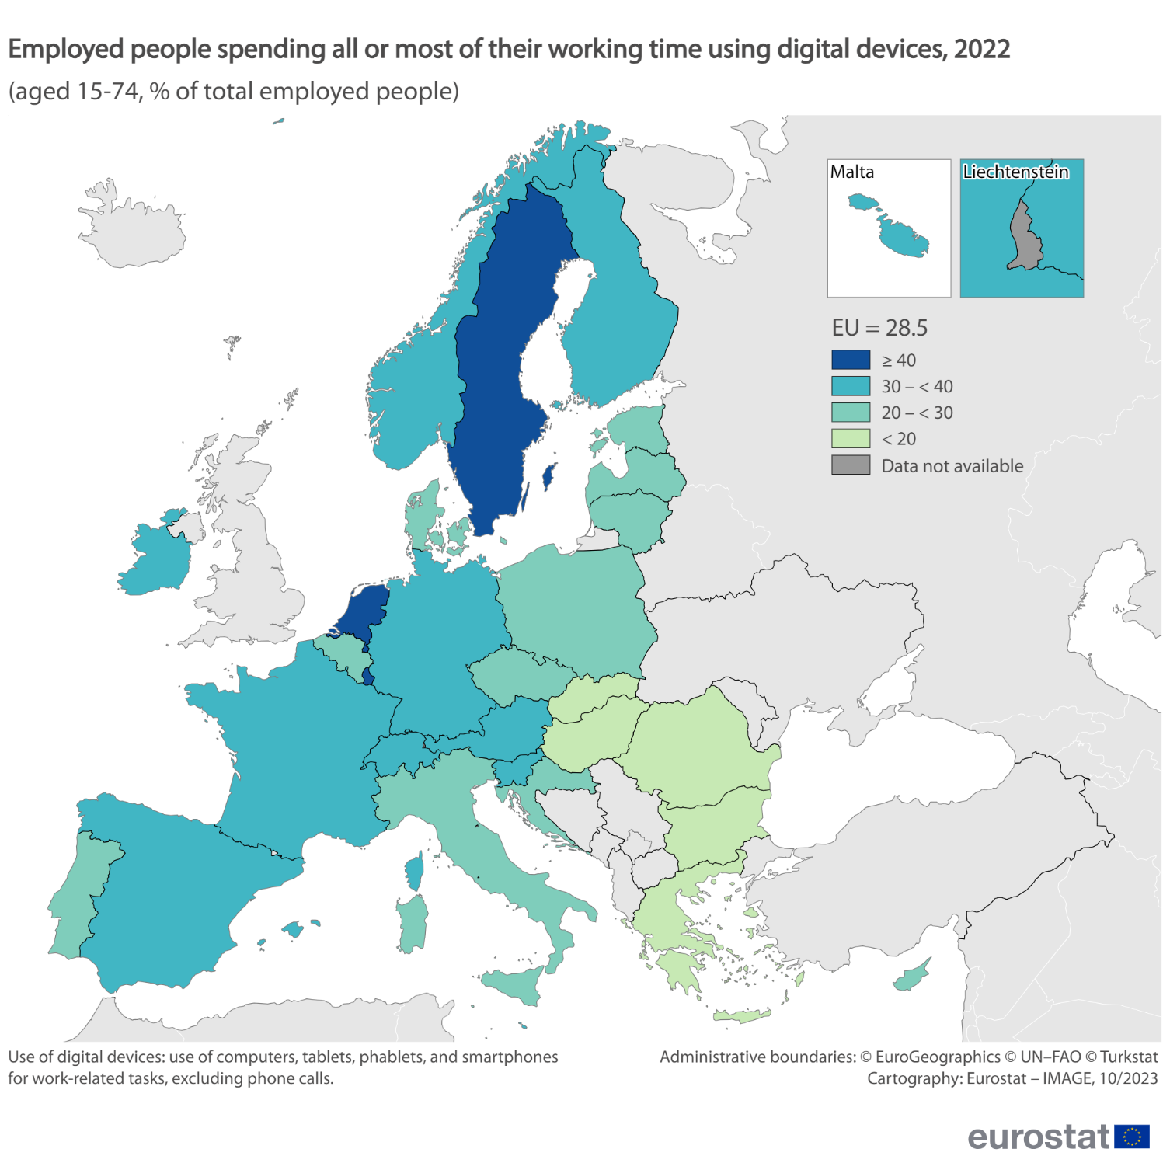
The use of digital devices at work
Highest shares in Luxembourg (47% of employed people), the Netherlands and Sweden (both 41%).
Lowest shares in Romania, Bulgaria and Greece (all 12%).

Slide 14
Working time spent on tasks involving social skills

Slide 15
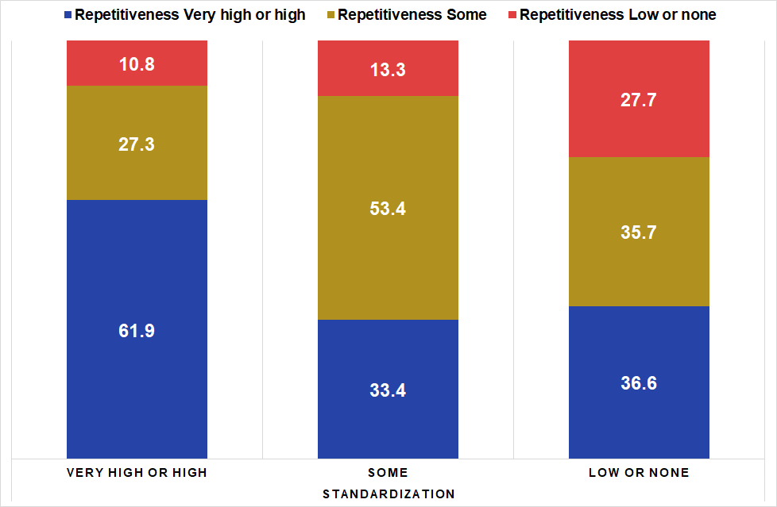
Distribution of levels of Repetitiveness by levels of Standardization, in 2022

Slide 16
IV. Most wanted skills and occupations: first results
Source: web-scraped data
Denis Leythienne

Slide 17
Demand for skills: first insights from web-scraped data
Web scraping: extracting data from online job advertisements
Title:
Data scientist
DATA SCIENTIST
Location: Luxembourg
Application deadline: Monday, 30 September 2019
Reference number: 100
Area:
Luxembourg
Time:
Saturday, 30 September 2019
APPLY NOW
Structured data
Home > Now Hiring > Data Scientist
Description:
This role will directly support the Head of Data Labs in the design and implementation advanced analytics as part of the Group-wide Data and Analytics strategy. We are seeking a high calibre creative thinker who can turn business problems into solutions by applying sophisticated and targeted analytics. The role will be project based, working as part of the wider Data Labs team to put analytics into practice across the organisation.
This role will directly support the Head of Data Labs in the design and implementation …
Description
Natural language data

Slide 18
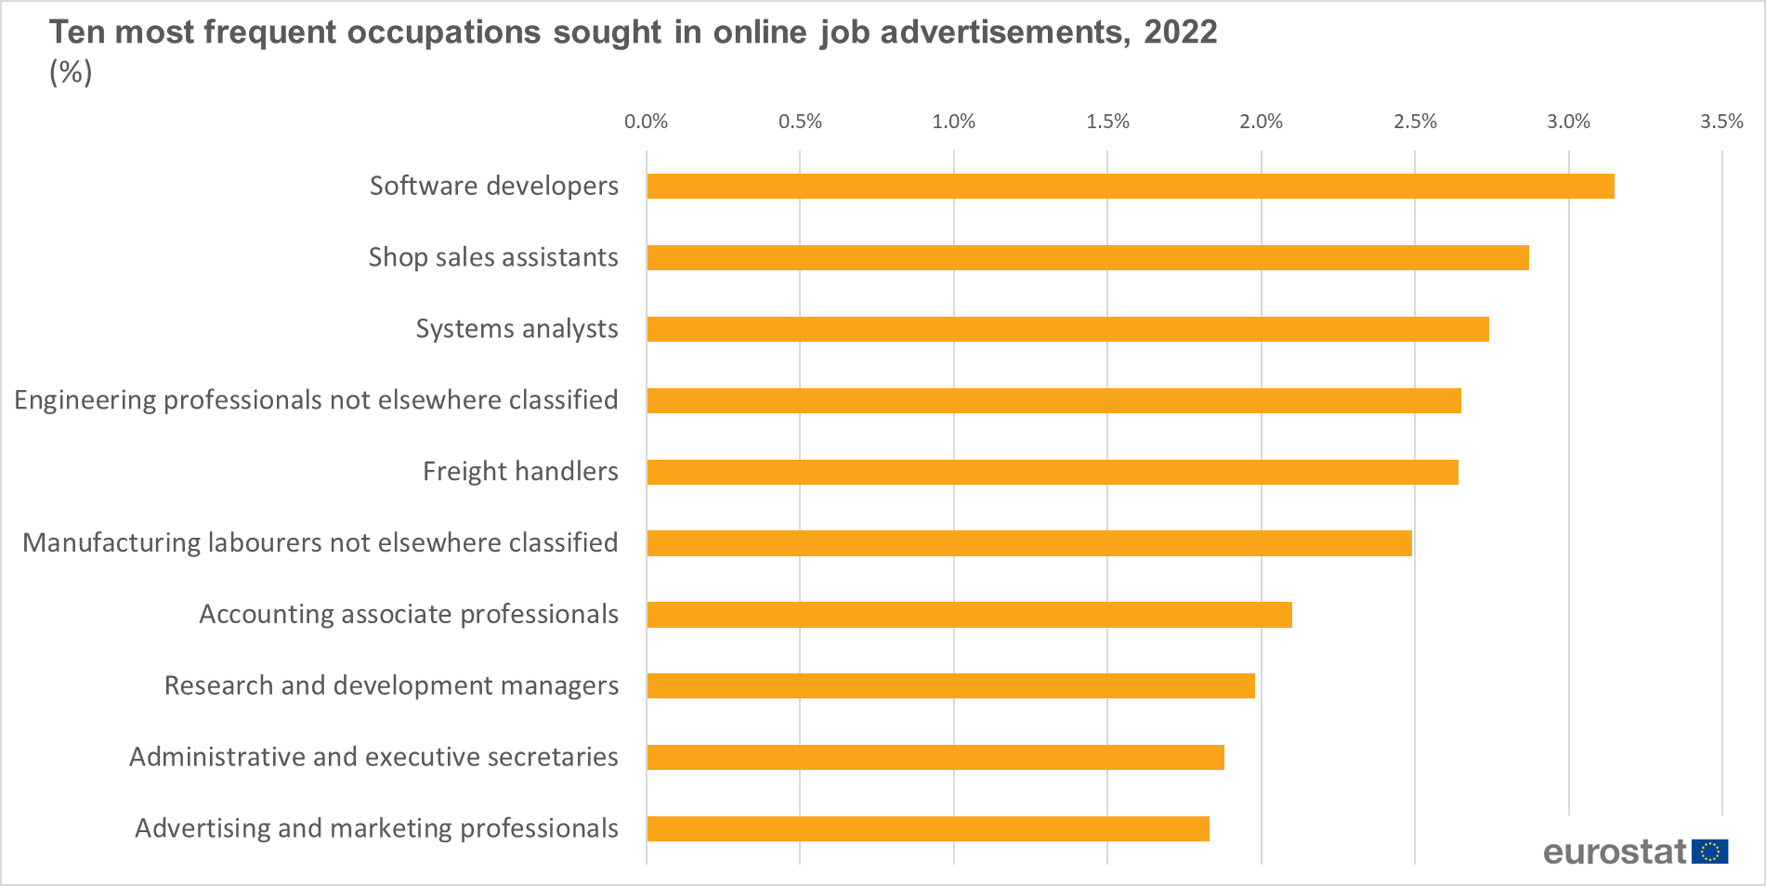
a) Most frequent occupations (ISCO classification)

Slide 19
Most frequent skills sought (word cloud)

Slide 20
Demand for skills: next steps
Display skills by category:
- general (‘soft‘) / specific skills
- digital skills
Display the most wanted skills for each occupation
For more information on labour demand:
https://ec.europa.eu/eurostat/statistics-explained/index.php?title=Job_vacancy_statistics

Slide 21
Thank you
© European Union 2020
Unless otherwise noted the reuse of this presentation is authorised under the CC BY 4.0 license. For any use or reproduction of elements that are not owned by the EU, permission may need to be sought directly from the respective right holders.
Slide xx: element concerned, source: e.g. Fotolia.com; Slide xx: element concerned, source: e.g. iStock.com
Notes:
Update/add/delete parts of the copy right notice where appropriate.
More information: https://myintracomm.ec.europa.eu/corp/intellectual-property/Documents/2019_Reuse-guidelines%28CC-BY%29.pdf

