Slide 1
High-technology and knowledge-intensive sectors

Slide 2
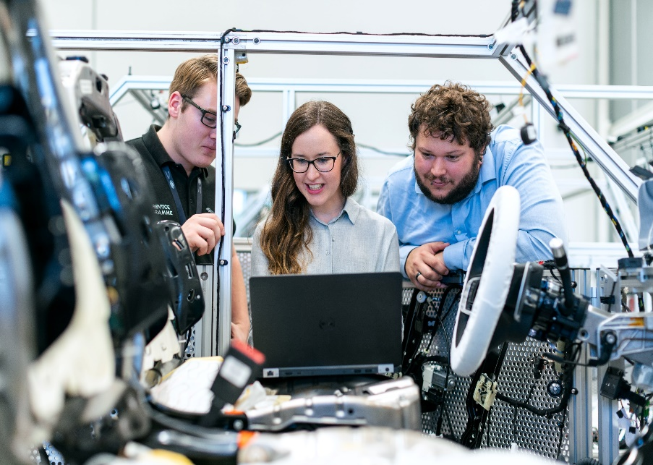
High-technology and knowledge-intensive sectors
High-technology industries
activities classified based on the expenditure on R&D (research and development)
Knowledge-intensive services
Compared to HRST
–persons are included regardless of their qualifications
-cover a narrower part of the economy
activities classified by the levels of tertiary-educated persons employed

Slide 3
Classification of industriesand services - examples
High-technology sectors
Manufacturing | Services
High-technology manufacturing: pharmaceutical, computers, electronics | Knowledge intensive services: -water and air transport -publishing, video & TV production, broadcasting, telecom, computer programming, information services -consultancy, financial and legal activities -architecture, engineering, scientific research -public administration, HR, education
Medium-high technology manufacturing: chemicals, machinery
Medium-low technology manufacturing: rubber, petroleum, plastic products
Low technology manufacturing: food, textile, wood, paper | High-technology knowledge-intensive services: -video & TV production, broadcasting, telecom, computer programming, information services -scientific research

Slide 4
EU participation of women in high-tech sectors - by country

Slide 5
Gender balance of EU employment in high-technology and knowledge-intensive services

Slide 6
Gender balance of EU scientists and engineers in some activity sectors

Slide 7
Research and development (R&D)

Slide 8
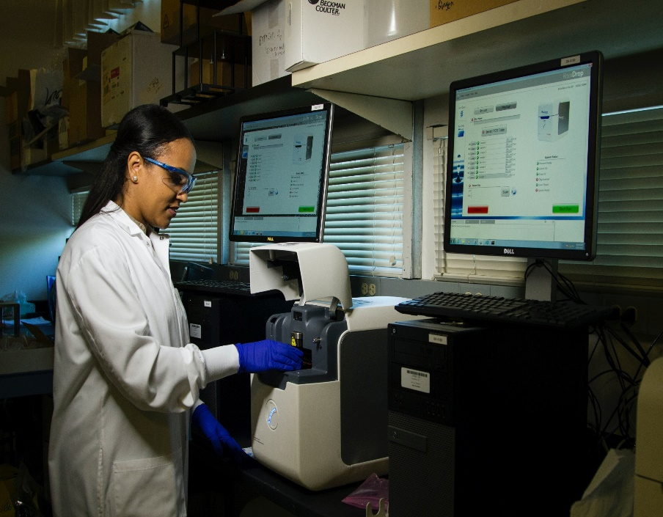
Research and development (R&D)
R&D: systematic work to increase the stock of knowledge and to find new applications of existing knowledge
-cover all fields of knowledge (e.g. culture, society)
R&D personnel: all persons employed or providing direct R&D services (including R&D managers, administrators and clerical staff)
Researchers: a subset of the R&D personnel based on the level of responsibility in conducting research
Compared to HRST
–excludes people not directly engaged on R&D in their current work
-includes anybody working on R&D, regardless of occupation or qualification

Slide 9
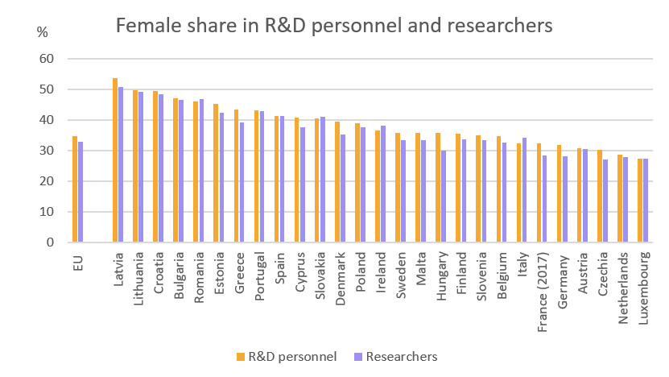
EU share of female R&D personnel and researchers, by country, 2019

Slide 10
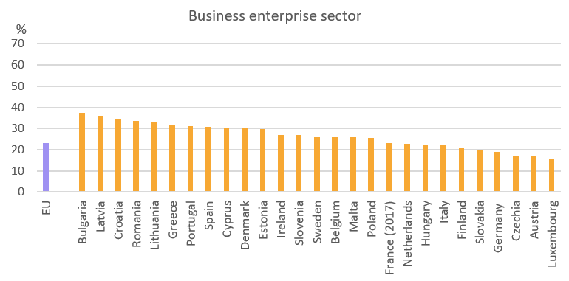
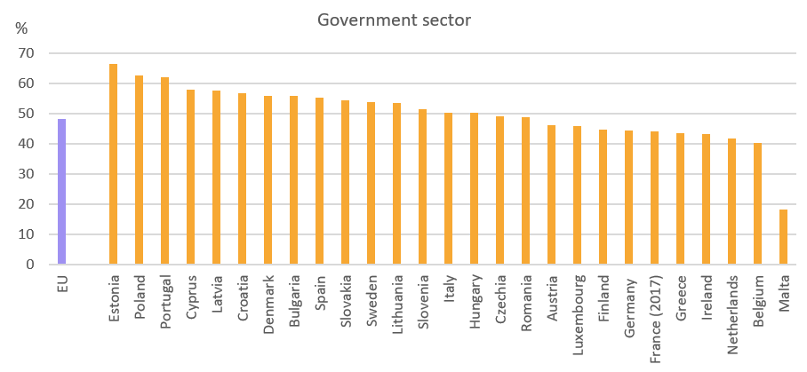
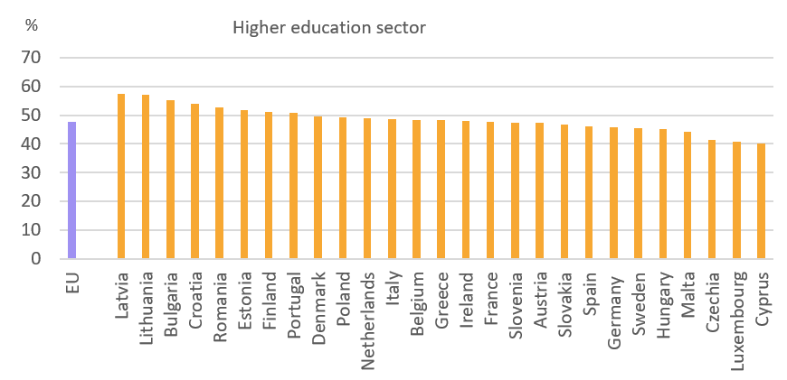
Share of female R&D personnel –by economic sector, 2019

Slide 11
EU evolution of the number of women and their share in the total R&D personnel and researchers

Slide 12
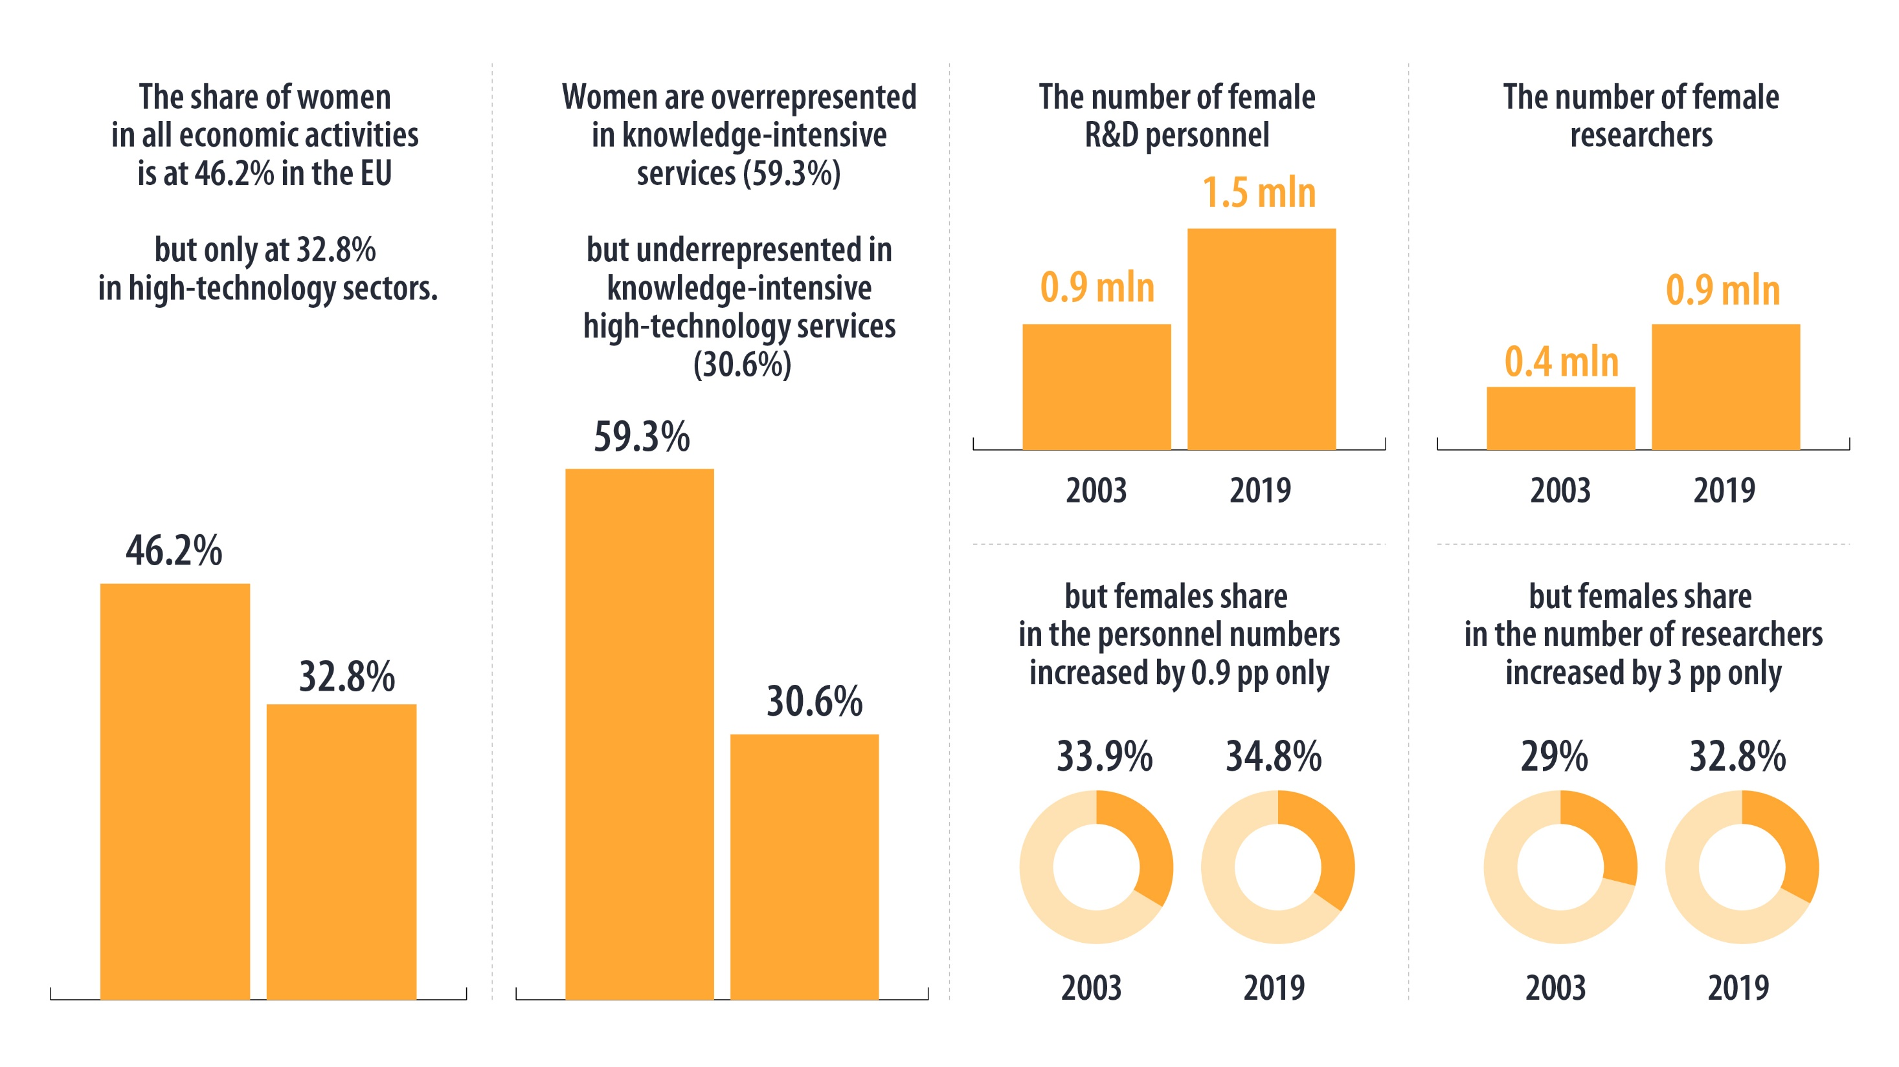

Slide 13
Where to find our data? https://ec.europa.eu/eurostat/data/database

Slide 14
Where to find our data? https://ec.europa.eu/eurostat/data/database

Slide 15
For more information see our dedicated section https://ec.europa.eu/eurostat/web/science-technology-innovation/overview

Slide 16
Thank you
© European Union 2023
Unless otherwise noted the reuse of this presentation is authorised under the CC BY 4.0 license. For any use or reproduction of elements that are not owned by the EU, permission may need to be sought directly from the respective right holders.
Slide xx: element concerned, source: e.g. Fotolia.com; Slide xx: element concerned, source: e.g. iStock.com

